Slide 1

My Linear Relationships Interactive Notebook
Name
Class
Teacher
Semester 2
Term 4
1

Slide 2
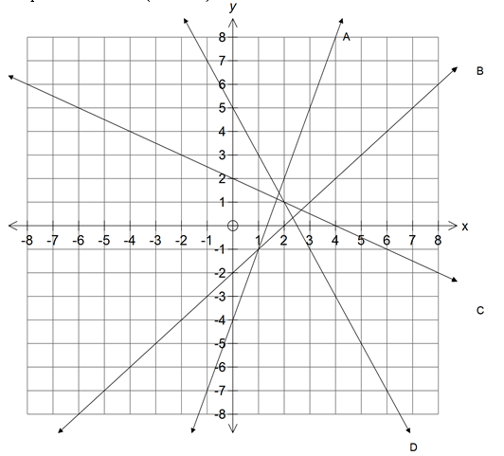
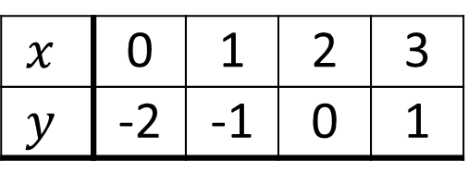
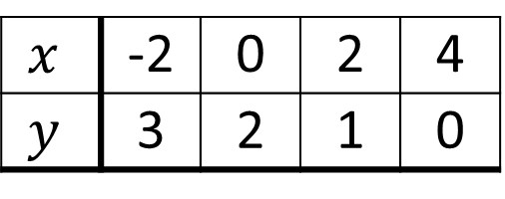
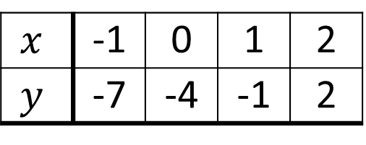
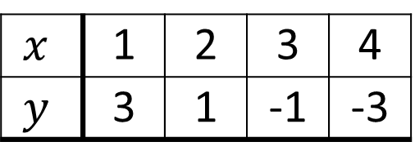
From Last Lesson
Match the line on the graph to the table of values
$$x$$ | 0 | 1 | 2 | 3
$$y$$ | -2 | -1 | 0 | 1
$$x$$ | 1 | 2 | 3 | 4
$$y$$ | 3 | 1 | -1 | -3
$$x$$ | -1 | 0 | 1 | 2
$$y$$ | -7 | -4 | -1 | 2
$$x$$ | -2 | 0 | 2 | 4
$$y$$ | 3 | 2 | 1 | 0

Slide 3
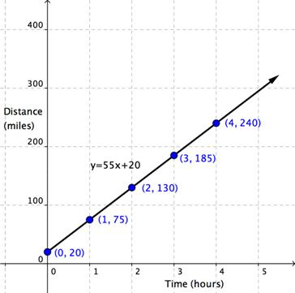
24
7
30
Date
Linear Relationships
EQ – How do I plot a linear equation on a graph?
What is a linear relationship?
If two sets of variables are graphed and form a straight line, we call the relationship between those two variables linear (think linear = line).
An example of a linear relationship in the real world is speed (as time goes up by a consistent amount, so does distance).
A linear equation links those two variables and can be used to graph the relationship and to find the unknown variable.
For example y = 2x + 3
Insert question
Let’s say our linear relationship was the cost of a tree-loping job was equal to $40 per hour of work plus a $100 call out fee (just for coming out).
Our linear equation would be y = 40x + 100 (where y= cost and x= no. of hours).
We don’t know how long the job will take yet so we don’t know what it will cost. To work out the cost for each hour it’ll take, we could graph this equation.
So how do we turn our equation into a graph?

Slide 4
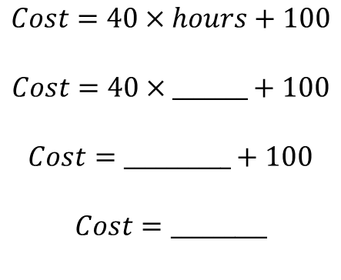
24
7
30
Date
Linear Relationships
EQ – How do I plot a linear equation on a graph?
How do I create a table from an equation?
Equation y = 40x + 100
Hours (x) | 0 | 1 | 2 | 3 | 4 | 5 | 6
Cost (y)
100
$$Cost=40×hours+100$$
$$Cost=40×_______+100$$
$$Cost=__________+100$$
$$Cost=_________$$
0
0
$100

Slide 5
24
7
30
Date
Linear Relationships
EQ – How do I plot a linear equation on a graph?
How do I create a table from an equation?
Equation y = 40x + 100
Hours (x) | 0 | 1 | 2 | 3 | 4 | 5 | 6
Cost (y)
100
140
$$Cost=40×hours+100$$
$$Cost=40×_______+100$$
$$Cost=__________+100$$
$$Cost=_________$$
1
40
$140

Slide 6
24
7
30
Date
Linear Relationships
EQ – How do I plot a linear equation on a graph?
How do I create a table from an equation?
Equation y = 40x + 100
Hours (x) | 0 | 1 | 2 | 3 | 4 | 5 | 6
Cost (y)
100
140
180
220
260
300
340
$$Cost=40×hours+100$$
$$Cost=40×_______+100$$
$$Cost=__________+100$$
$$Cost=_________$$
2
80
$180

Slide 7
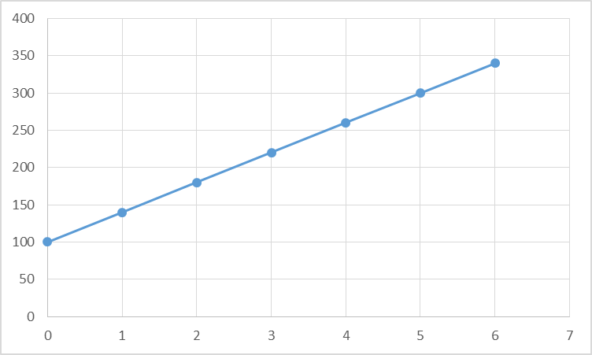
24
7
30
Date
Linear Relationships
EQ – How do I plot a linear equation on a graph?
How do I create a table from an equation?
Equation y = 40x + 100
Hours (x) | 0 | 1 | 2 | 3 | 4 | 5 | 6
Cost (y)
100
140
180
220
260
300
340
How do I create a graph from a table?
(6,340)
If the job takes 2 hours, it’ll cost $_______
(5,300)
(4,260)
(3,220)
(2,180)
If the job can only cost a maximum of $300, it must be done in ______ hours
(1,140)
(0,100)

Slide 8
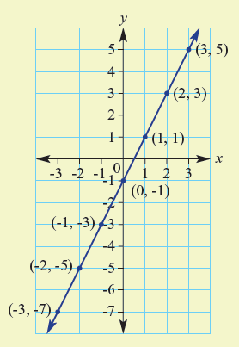
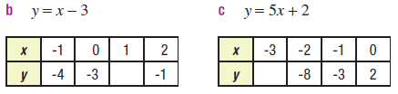
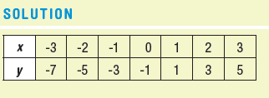
Let’s try some together

